Slide 1
Git and using GitHub
Unless you don’t like being able to work with other people and see the changes you made in the past

Slide 2

FIRST THING’S FIRST!
Git ≠ GitHub
Git is Form of Version Control Software
AKA source control
Many other forms
GitHub is a place to host your Git Repositories online
Other websites offer this too like BitBucket

Slide 3

Ways to use Git
There are pretty much two main ways to use Git
Command Lines
Pros: You are really forced to understand Git
Cons: You are really forced to understand Git
GUI Tools (GitHub Desktop, Git Extensions, etc)
Pros: Way easier to use and manage code
Cons: This is how you look to some people

Slide 4
Gotta Get Git
Command Line
https://git-scm.com/downloads
Git Bash is just a Windows side application that opens a command prompt with Git
GitHub Desktop GUI (what I recommend at first)
https://desktop.github.com/

Slide 5
Git 101- What happens to code
Repository (the code) is saved on local computer
Repositories can then be Pushed to a remote server where other people can push too
GitHub (or other git server)
User 1
User 2
User 3
User 4

Slide 6
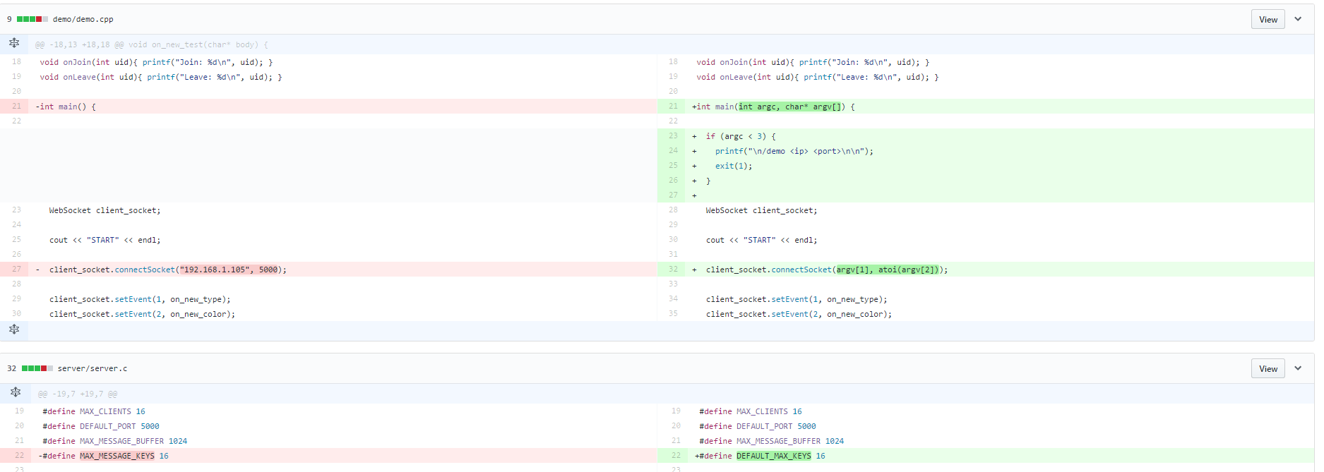
How Git Works
Keeps tracks of difference in lines of files

Slide 7




HW2
main.c
main.h
include
spi.c
spi.h

Slide 8
HW2
main.c
main.h
Include
spi.c
spi.h
BASE

Slide 9
HW2
main.c
main.h
Include
spi.c
spi.h
BASE
Change file
C1
+ main.c
+ main.h
Change file

Slide 10
HW2
main.c
main.h
Include
spi.c
spi.h
BASE
C1
+ main.c
+ main.h
C2
Change file
+ spi.c

Slide 11
HW2
main.c
main.h
Include
spi.c
spi.h
adc.c
BASE
C1
+ main.c
+ main.h
C2
+ spi.c
add file
C3
++ adc.c

Slide 12
HW2
main.c
Include
spi.c
spi.h
adc.c
BASE
Removed file
C1
+ main.c
+ main.h
Change file
C2
+ spi.c
C3
++ adc.c
C4
-- main.h
+ spi.c

Slide 13
BASE
C1
C2
C3
C4
main.c
main.h
Include/spi.c
Include/spi.h
Include/adc.c
v0
v1
v1
v1
v1
v0
v1
v1
v1
---
v0
v0
v1
v1
v2
v0
v0
v0
v0
v0
---
---
---
v0
v0

Slide 14
It Remembers …so you don’t have too
Git saves all past Committed saves in a .git file in the repository
New people can go back to ANY old Commit made during life of repository

Slide 15
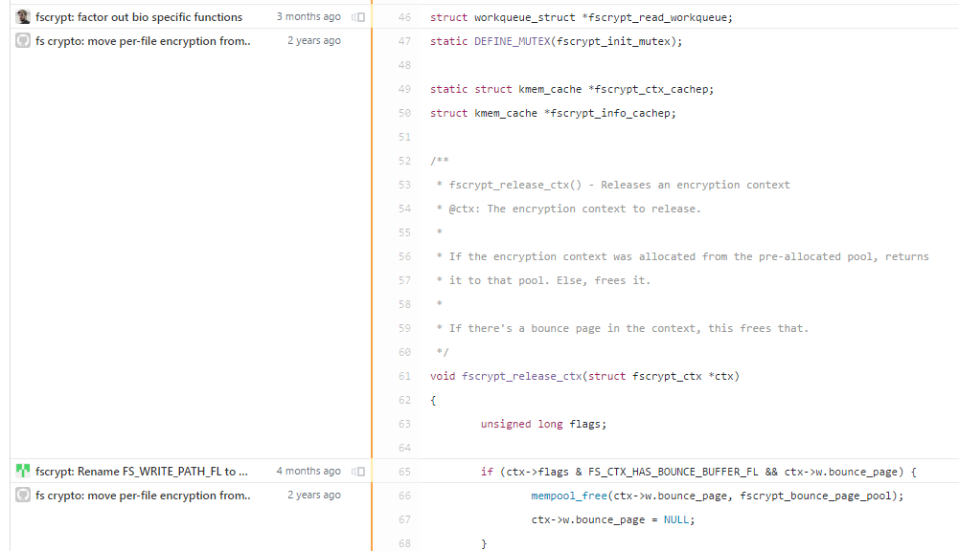
You can even “blame” others
Git’s blame feature allows you to see each line last change

Slide 16
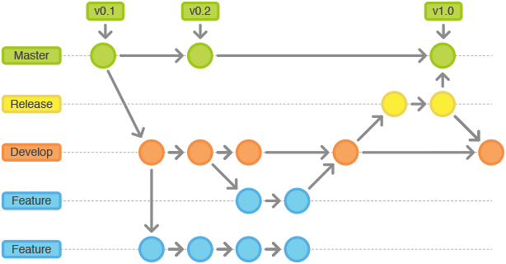
Git 101 - Branches
Branches let you work on the code in your own crazy direction and Merge it back later
Example: Make a “New-Feature” branch and when it is ready, Merge back to the Master Branch

Slide 17
Git 101 – Workflow
Fetch/Pull
Make your edits
Stage your changes
Commit your work
Push

Slide 18
Git 101 – Workflow - Fetch
If you have not cloned the repo
git clone https://the.git.repo.git
Get the latest updates before working
git pull

Slide 19
Git 101 – Workflow - Edit
Add, remove, edit all the files you want

Slide 20
Git 101 – Workflow - Stage
Add the files you want to commit
This allows you to choice what to commit
git add –A
Will add all difference
git add main.c
Just adds main.c

Slide 21
Git 101 – Workflow – Commit
Take the “snapshot” of the folder
Add a commit title
Optionally add a comment
git commit –m “Best commit EVA”

Slide 22
Git 101 – Workflow - Push
When ready, push changes to server
git push

Slide 23
GitHub Permissions
For a project you can always just download the code and do what you want.
If you want to make changes, either Clone or Fork the Repository
You can then send a Pull Request that will let someone in charge of Repo check your changes and Merge it
If you set someone as a Collaborator they can Push code without having to submit a Pull Request

Slide 24
Almost Forgot about .gitignore
Git is not the best with Binary files (.mp3, .pdf, .exe, .FileTypeICannotReadInNotepad)
List all the folders and files that git will not recognize
Almost all types of projects have a standard .gitignore template found on GitHub

Slide 25
Merge Conflicts
Not that scary
Happens when same lines are altered in two different commits
Debunking the myth that merge conflicts are hard

Slide 26
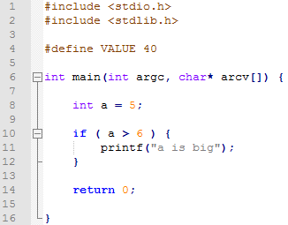
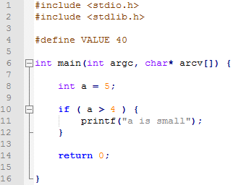
Commit from User 1
Commit from User 2
Merge Conflict will need to be resolved before able to merge
Just open the file in text editor

Slide 27
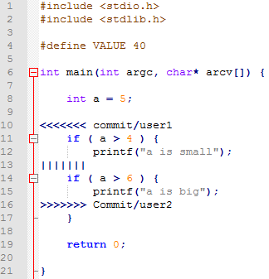
The Merge Conflict File
Change file to look the way you want and save
…simple, I know

Slide 28
GitHub GUI – Make new repo
Can either create online or bring it to local computer
Start new repository and push to GitHub when ready (If using a private repo, why wait)
HUGE SIDE NOTE: Go here if you haven’t before https://education.github.com/pack/offers and get your free private repositories
Can take a current set of code and make it into a Git repo
Will have no history prior to initialization of git

Slide 29
How to use GUI
If you want to learn more go here: https://guides.github.com/
If you want to get this repo go here
https://github.com/sjfricke/IEEE_RaspberryPi_Socket_Pokemon
Click the “Clone or Download” button and Clone it to your desktop (will open Desktop GUI for you)

Slide 30
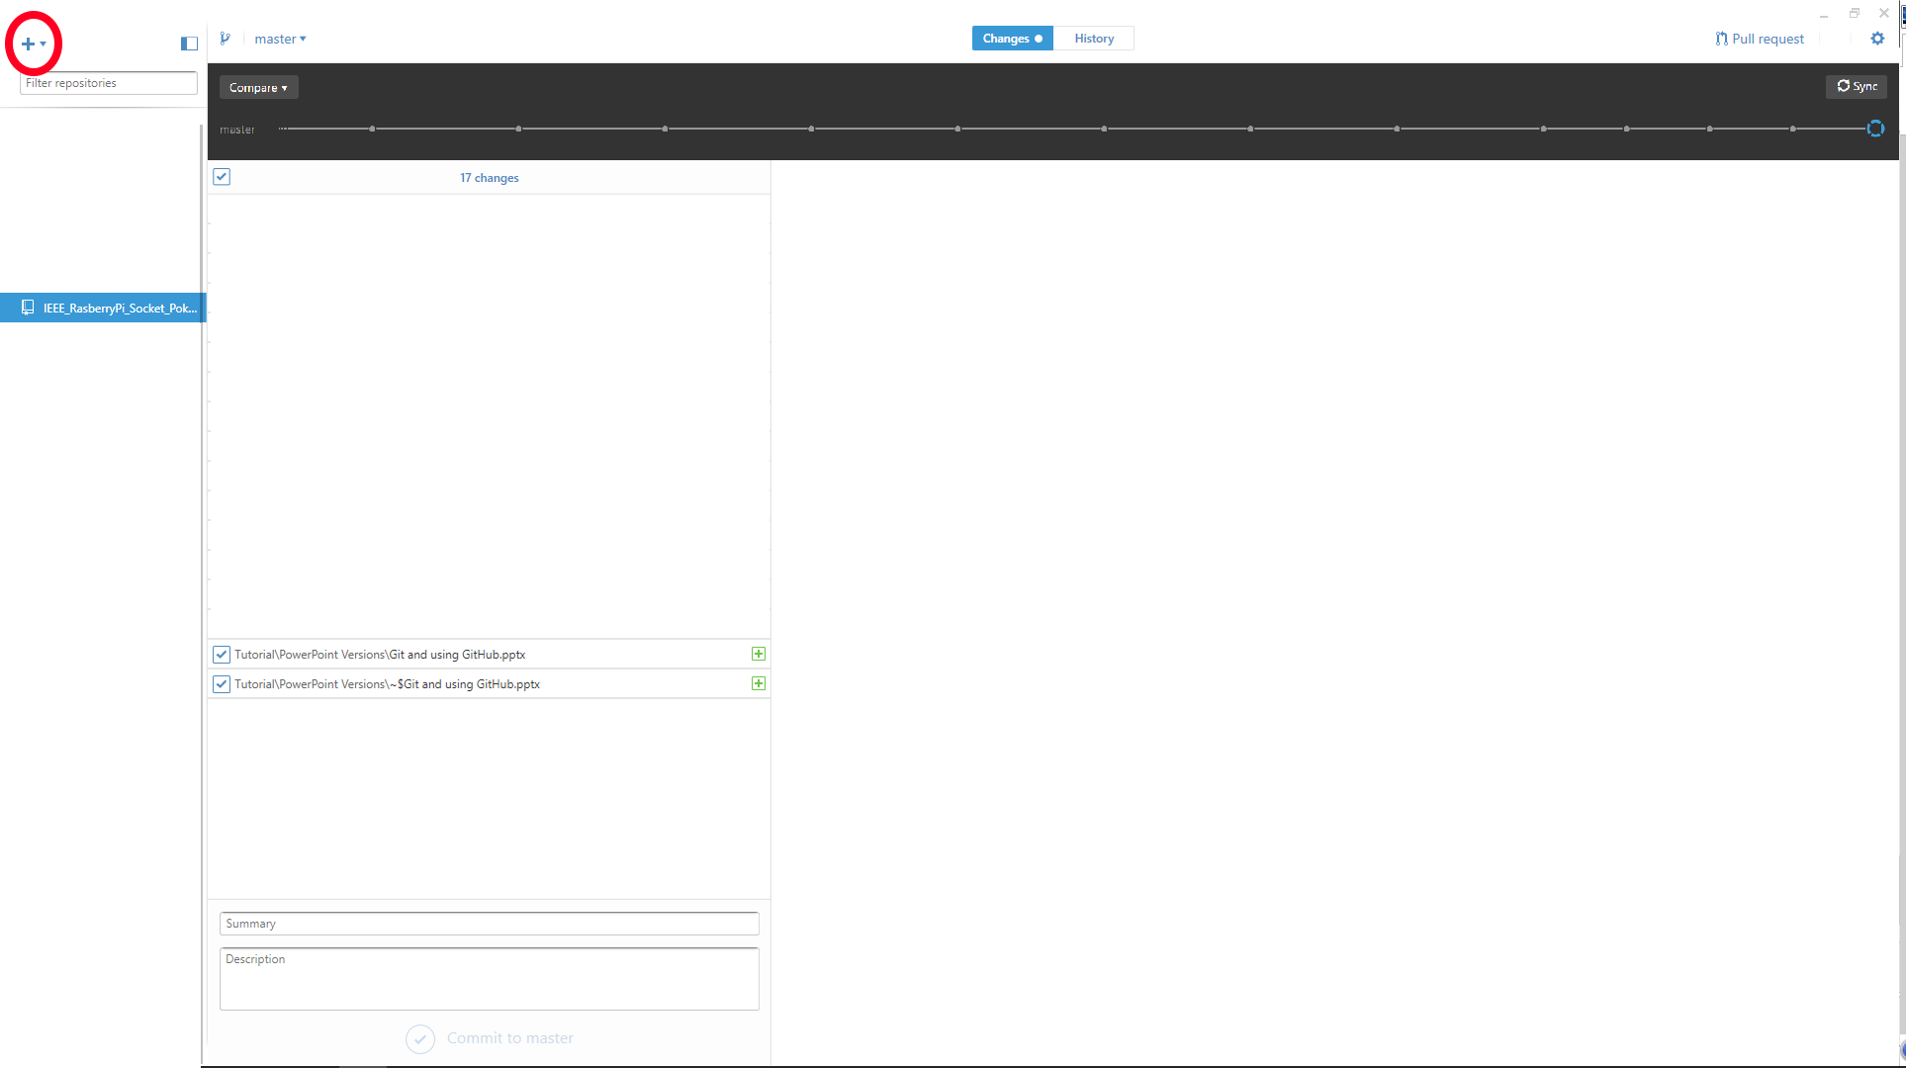
Click here to add the Repo

Slide 31
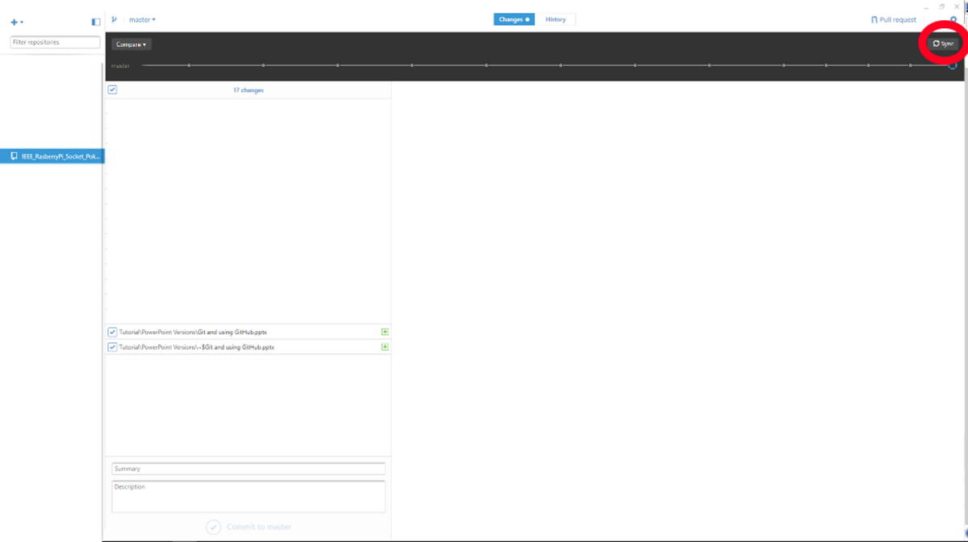
Click here to sync with Repo
Use to get the latest version (ALWAYS Do this before you start!)
If you are a Collaborator you can use this to push to Server

Slide 32
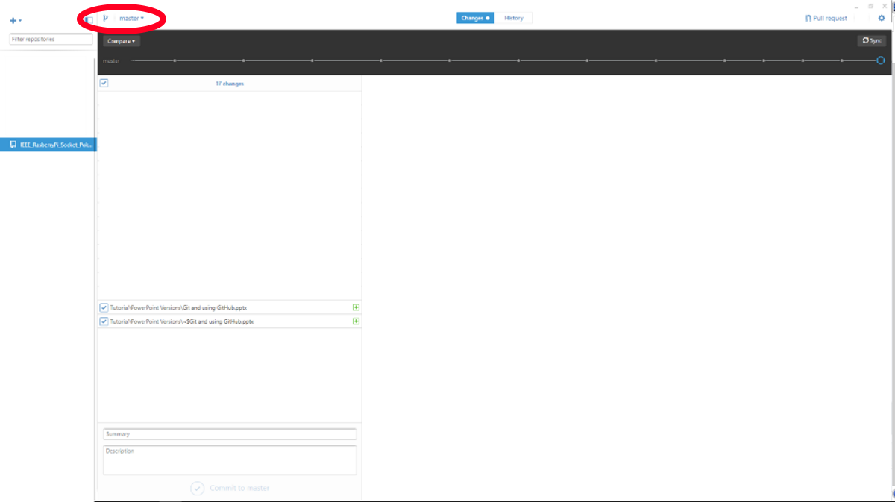
Either Add a new branch or switch between branches of the project

Slide 33
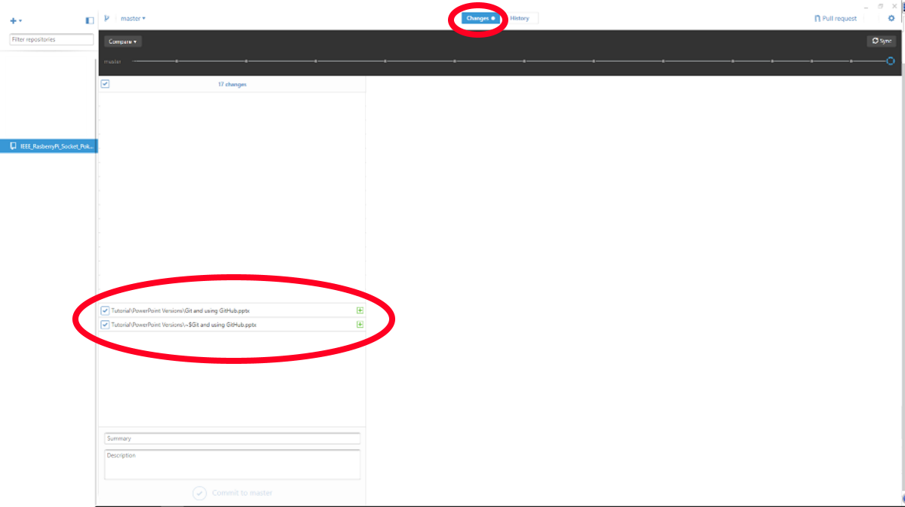
When in “Change” screen you can select which files you are Staging and want to add to the new changes

Slide 34
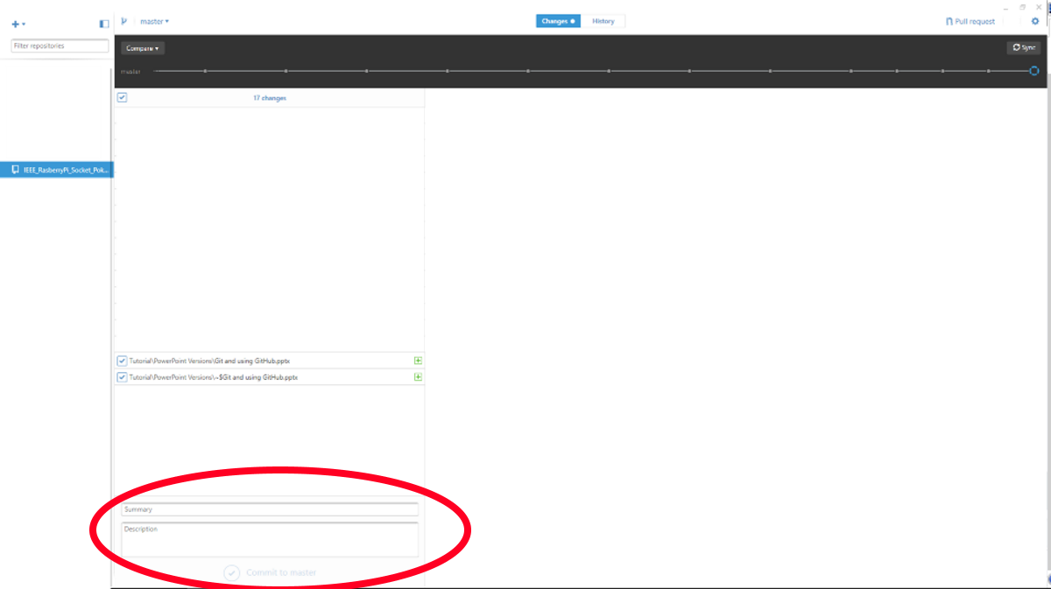
Add a Summary and Description to your Commit and Commit the changes
Remember, this is only committed on your local machine until you push the changes to the server

Slide 35
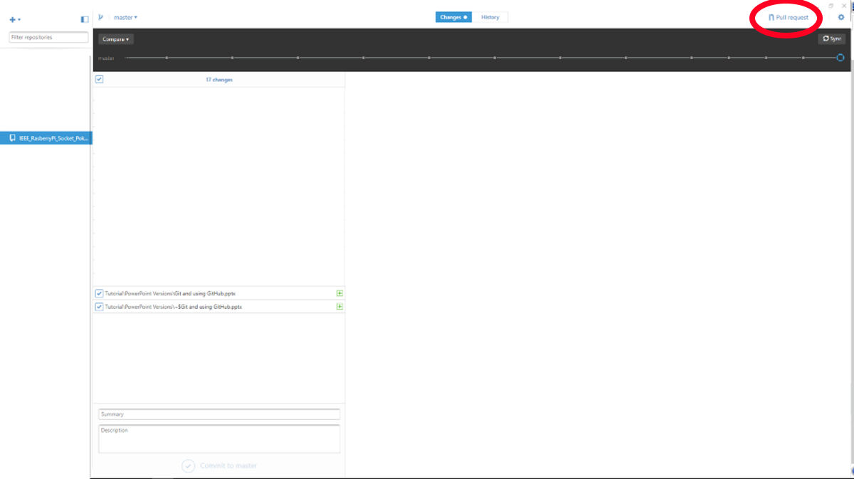
If your code is ready, you can send the Pull Request from here

Slide 36
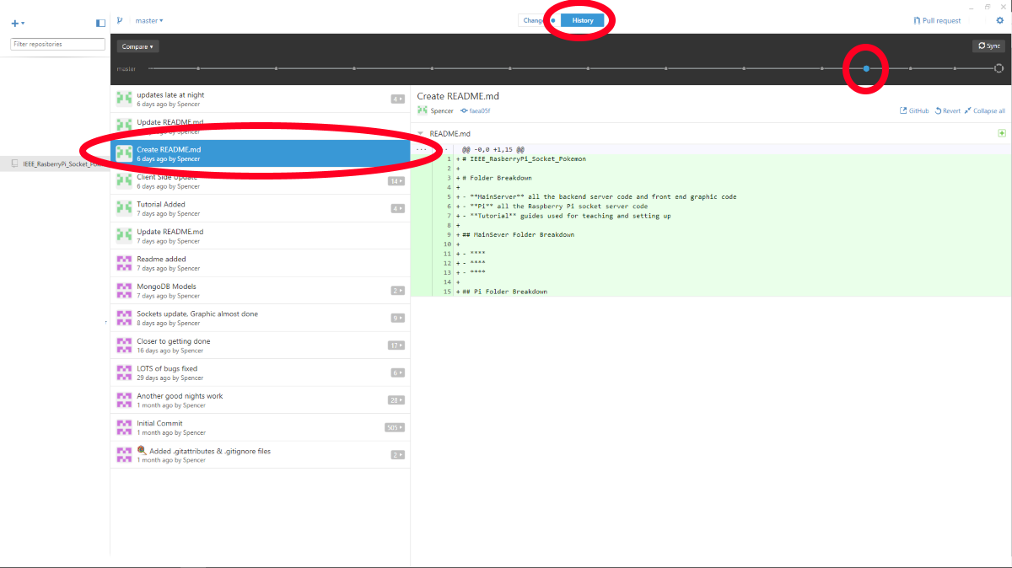
In the “History” screen you can see all the past Commits of the repository

Slide 37
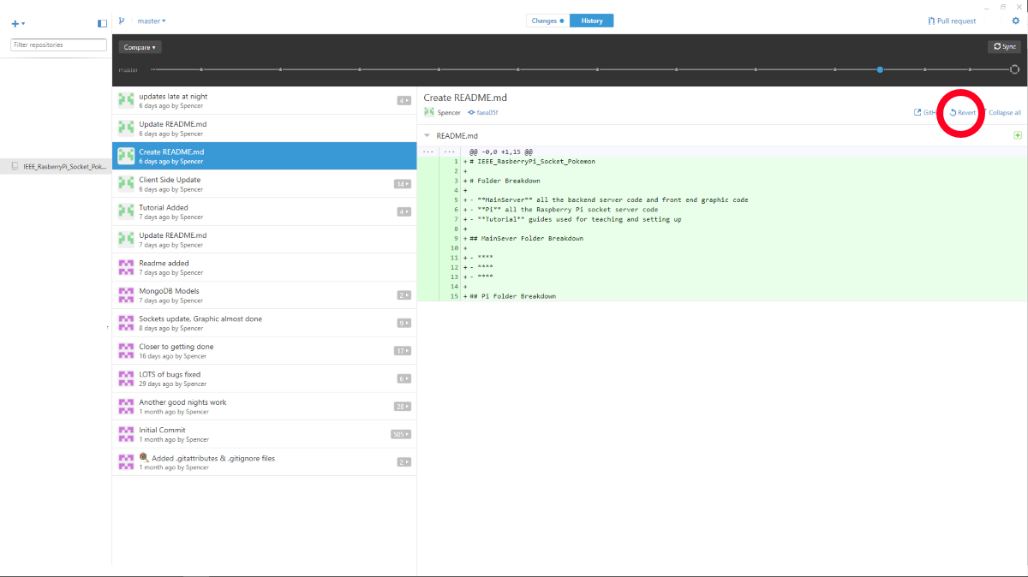
You can then Revert back to that point in the project… maybe start a new branch or see what you did or changed… this is WHY you use Version Control in the first place

Slide 38
Recap
Get Repository (Clone) or Sync it (Fetch)
Know which Branch you are in
Make your changes
Set which changes you are Staging
Commit the changes
When ready, Sync or send a Pull Request
Think how awesome it is you can now work on code projects with someone else, granted they probably didn’t comment it correctly, but that’s a different slide show I am not writing

Slide 39
Best Practice
These are the best two sites to practice with
https://try.github.io/levels/1/challenges/1
http://learngitbranching.js.org/
Here is a repo you can mess with
https://github.com/sjfricke/IEEE_Practice_Git

